Slide 1
Image Guide State by State: How suffragists used maps to work for equal voting rights
Women’s Long Road to the Vote
Teacher Materials, Lesson 1
Maine State Museum
2019

Slide 2
Part 1: Sharing ideas with images
Symbol (Noun):a thing that represents or stands for something else.

Slide 3






Do you recognize these symbols?

Slide 4
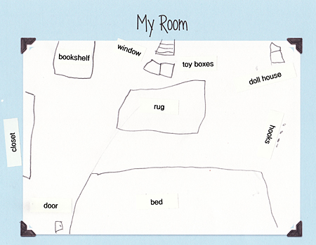
http://lets-explore.net/blog/2010/02/map-making-activities/
Notes:
Room map. Image courtesy of http://lets-explore.net/blog/2010/02/map-making-activities/

Slide 5
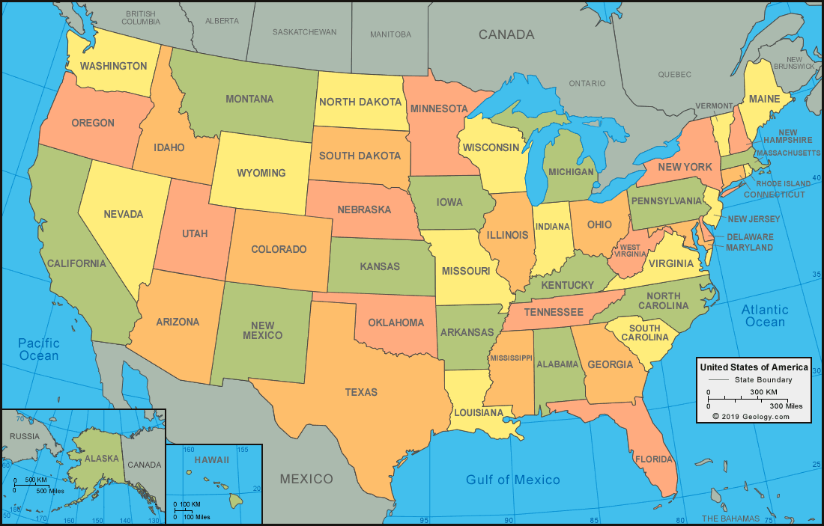
Notes:
United States Map. Image courtesy of https://geology.com/world/the-united-states-of-america-satellite-image.shtml

Slide 6
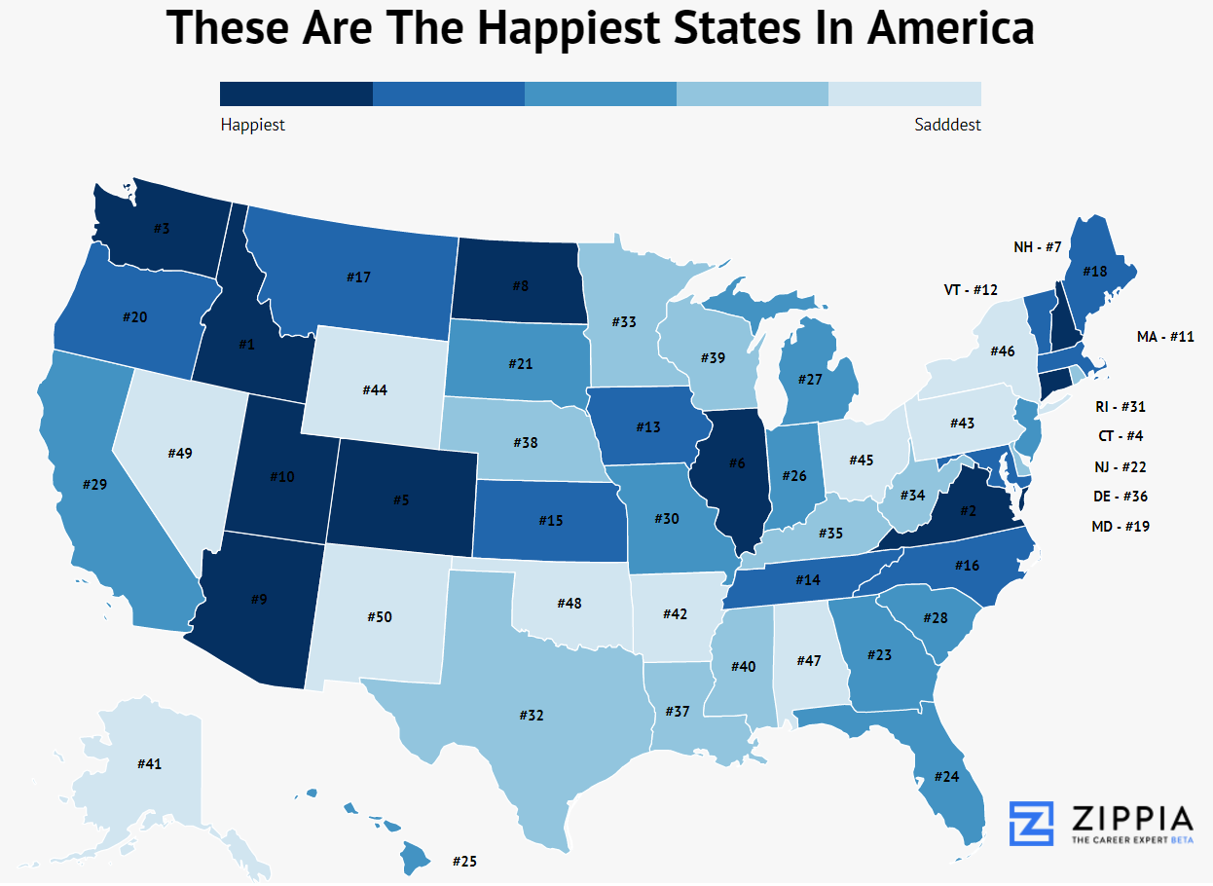
Notes:
Happiest states in America map. Image courtesy of https://www.zippia.com/advice/10-happiest-states-america/

Slide 7
Part 3: Maps as Tools for Change
“Are political rights to be a question of geography? The women of New York will be eligible to vote for the next President if the men of the Empire State are as generous-minded as the men of the West have been.”
-New York State suffrage flier, 1914-1915

Slide 8
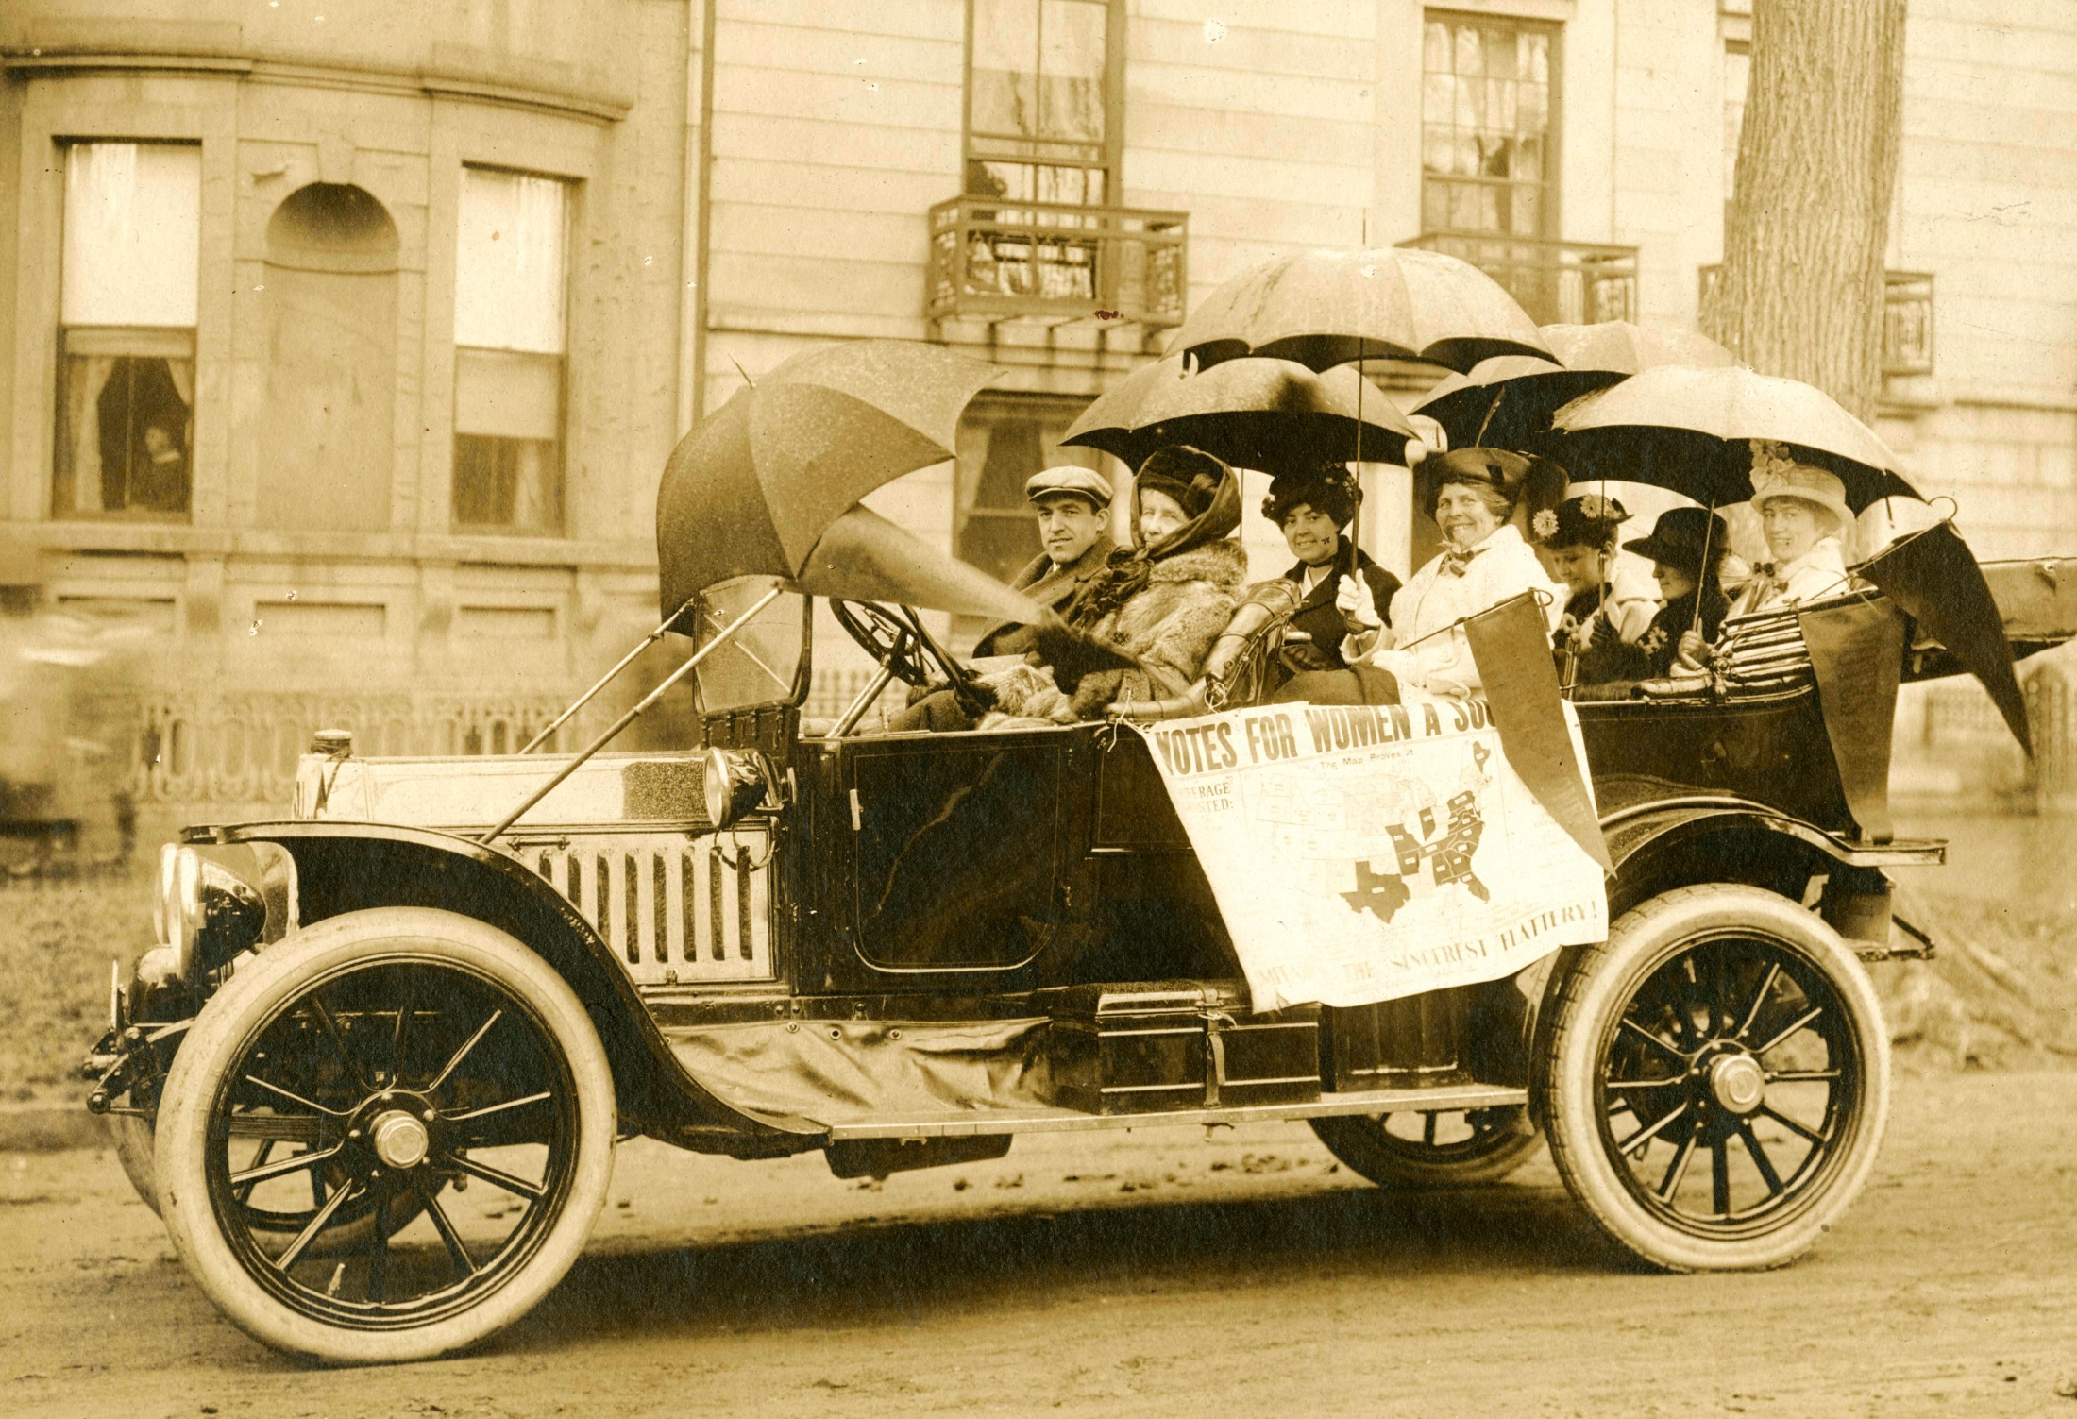
Notes:
Maine Suffragists in a Portland Maine parade, 1914. Image courtesy of the Maine State Museum collections.

Slide 9
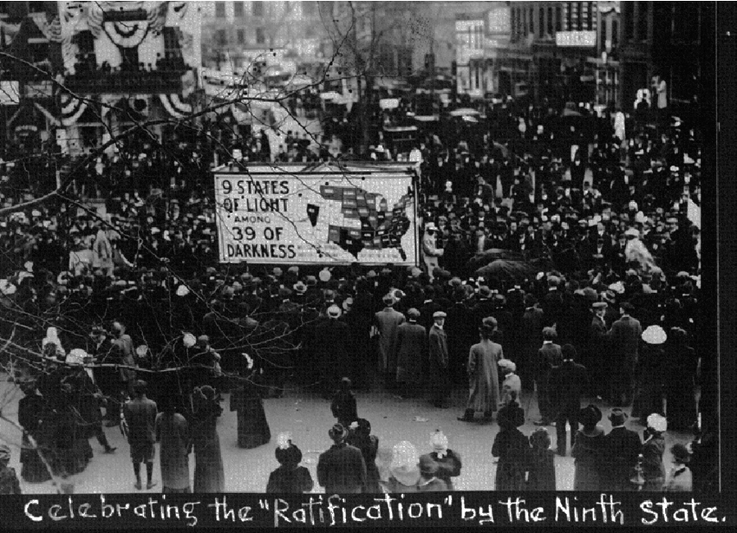
Notes:
‘‘Celebrating the ‘Ratification’ by the Ninth State’’ parade float in Omaha, Nebraska, 1912. Image courtesy of https://www.researchgate.net/figure/Celebrating-the-Ratification-by-the-Ninth-State-parade-float-in-Omaha-1912-from_fig4_220144083

Slide 10
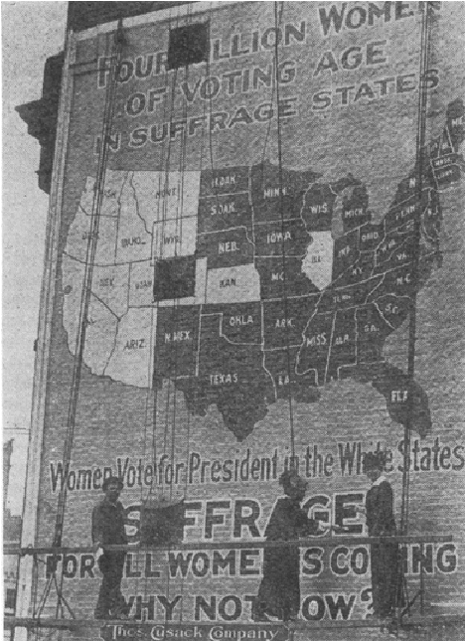
Notes:
1916 suffrage billboard. Image courtesy of https://www.researchgate.net/figure/1916-suffrage-billboard-Susan-B-Anthony-Ephemera-Collection-Huntington-Library-eph_fig5_220144083

Slide 11
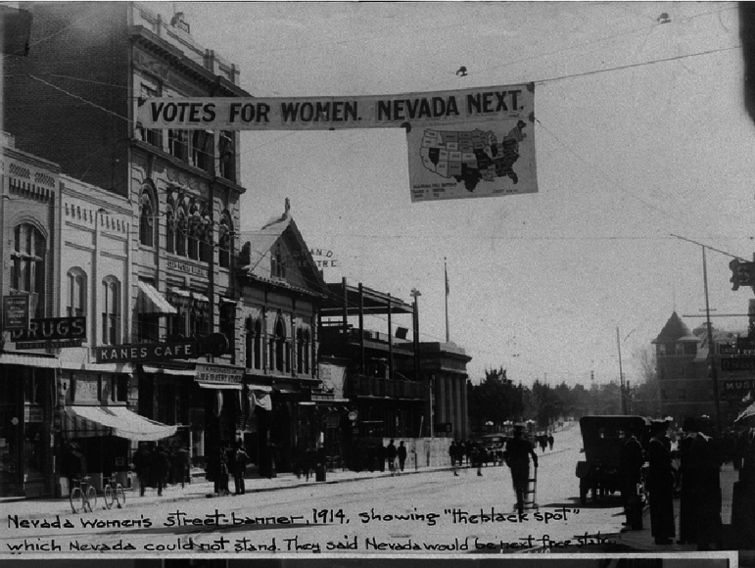
Notes:
Nevada street scene with suffrage banner, 1914. Image courtesy of https://www.researchgate.net/figure/Nevada-street-scene-with-suffrage-banner-1914-from-Carrie-Chapman-Catt-Photograph-Album_fig8_220144083

Slide 12
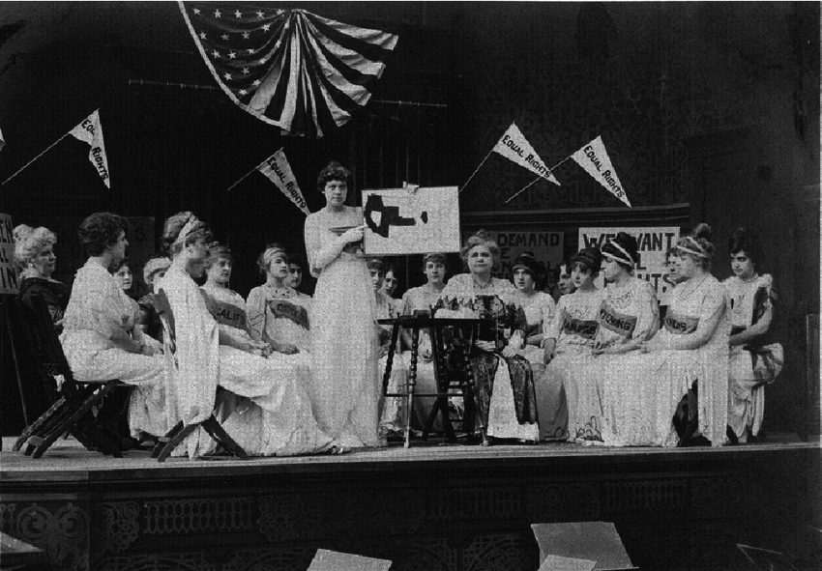
Notes:
Still from the silent film Your Girl and Mine, 1914. Image courtesy of https://www.researchgate.net/figure/Still-from-the-silent-film-Your-Girl-and-Mine-1914-from-Carrie-Chapman-Catt-Photograph_fig9_220144083

Slide 13
Part 4: Analyzing the Maps

Slide 14
Warmup Activity: Fact vs. Opinion Looking closely at images
Step one: Look carefully at an image.
Step two: Facts—List everything you see in the image.
Step three: Opinions—say what you think about the photo based on what you see. Back it up with evidence!
Notes:
Image source: https://www.google.com/url?sa=i&source=images&cd=&cad=rja&uact=8&ved=2ahUKEwj2rfKb4e3gAhWKTd8KHdgcAvMQjB16BAgBEAQ&url=https%3A%2F%2Fwww.seniorconcerns.org%2Fscreening-for-memory-loss%2Fhungry-dog%2F&psig=AOvVaw0jK_OiI2t4HGPEKeXzV7mI&ust=1551970076026909

Slide 15
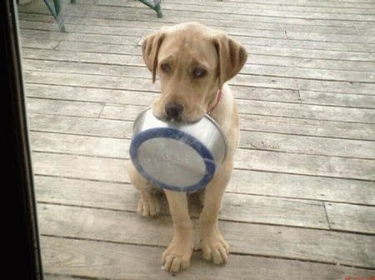
Let’s Practice!
What do you see?
Facts
Describe what you see
2. Opinions
What do you think is happening, and why?

Slide 16

Let’s Try One More!
What do you see?
Fact
Describe what you see
2. Opinion
What do you think is happening, and why?
America Chavez comic by Joe Quinones, Gabby Rivera https://www.pinterest.com/pin/632052128929988240/
Notes:
America Chavez comic by Joe Quinones, Gabby Rivera. Image courtesy of https://www.pinterest.com/pin/632052128929988240/

Slide 17
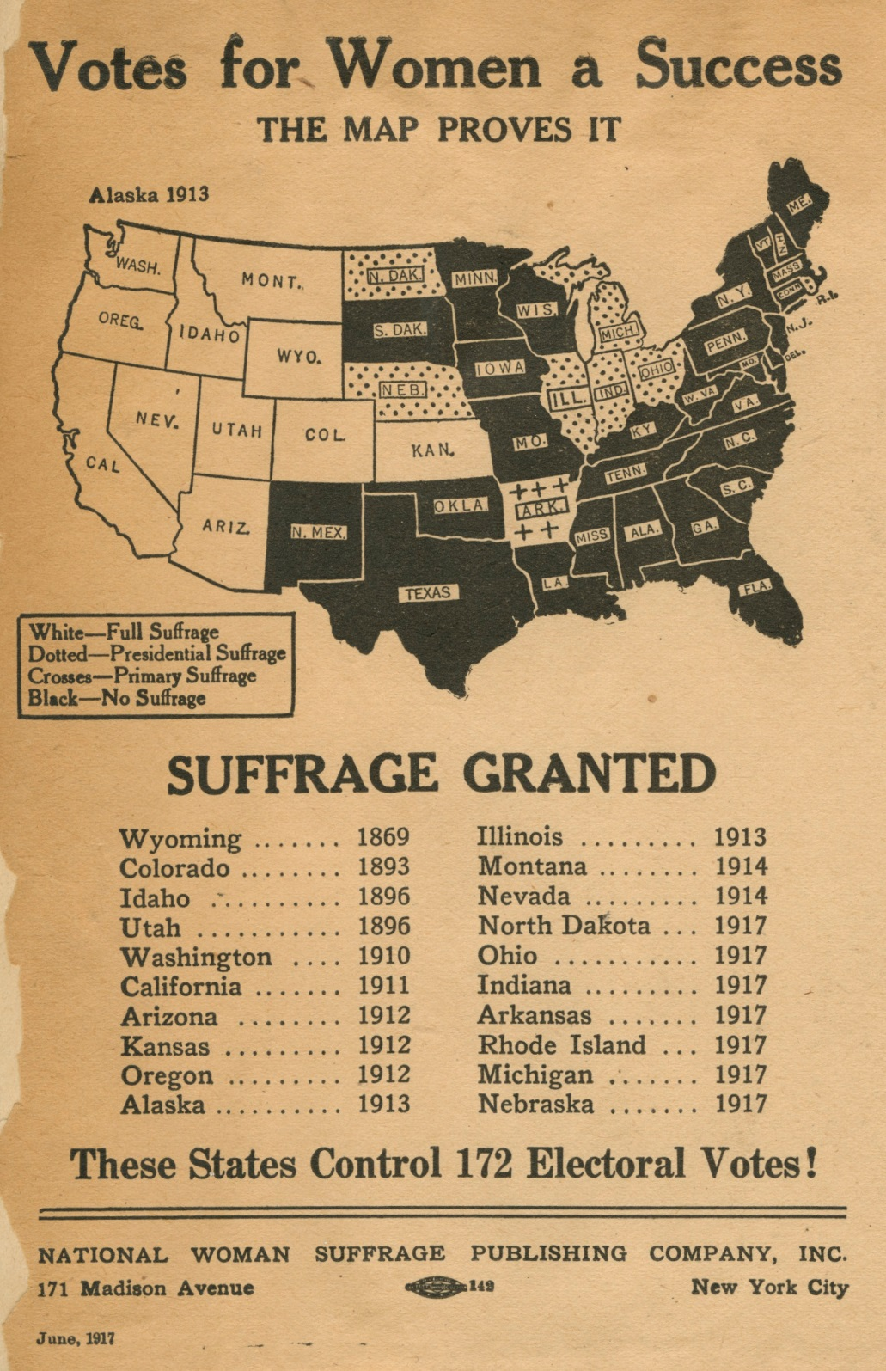
Notes:
Suffrage Scrapbook

Slide 18
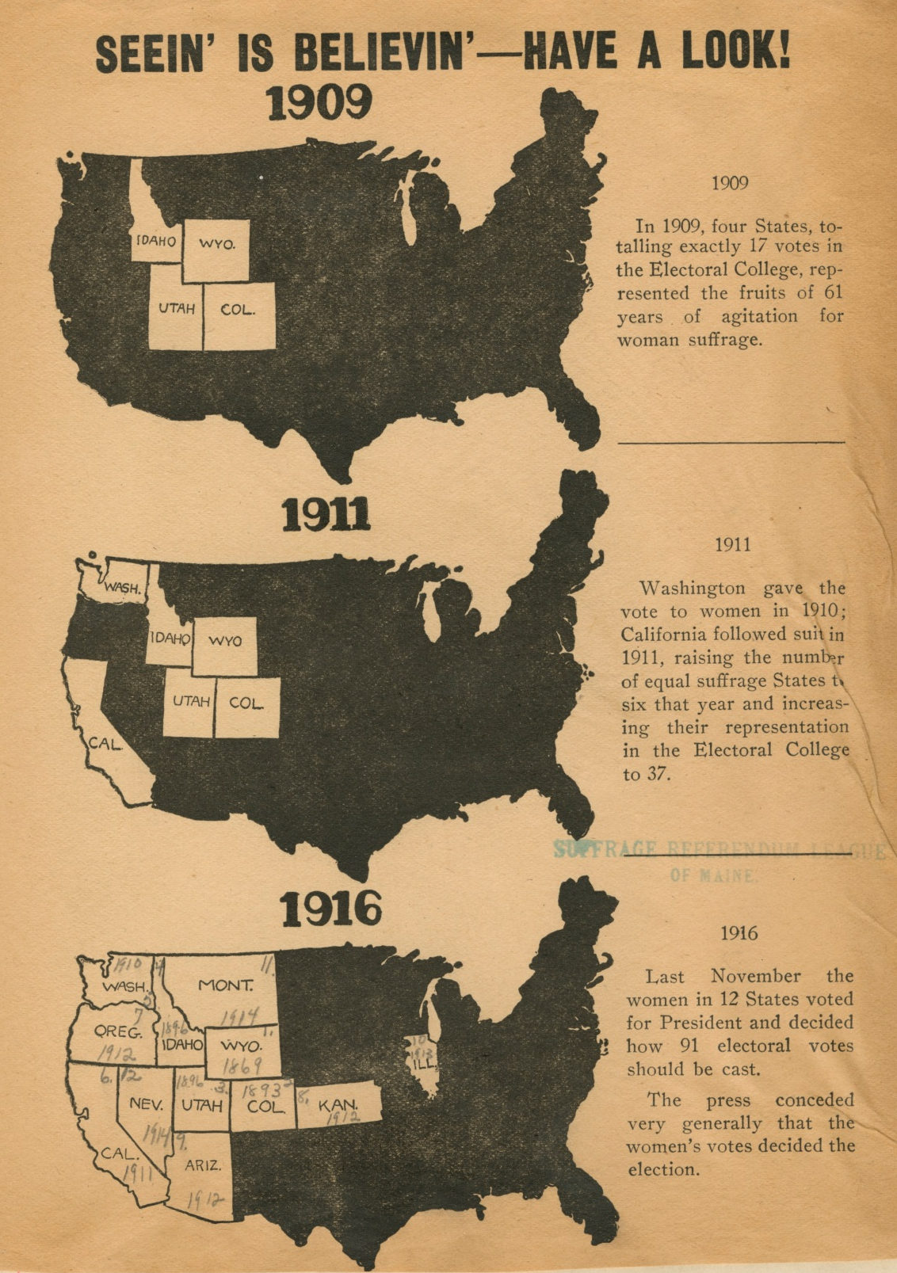
Notes:
Suffrage Scrapbook

Slide 19
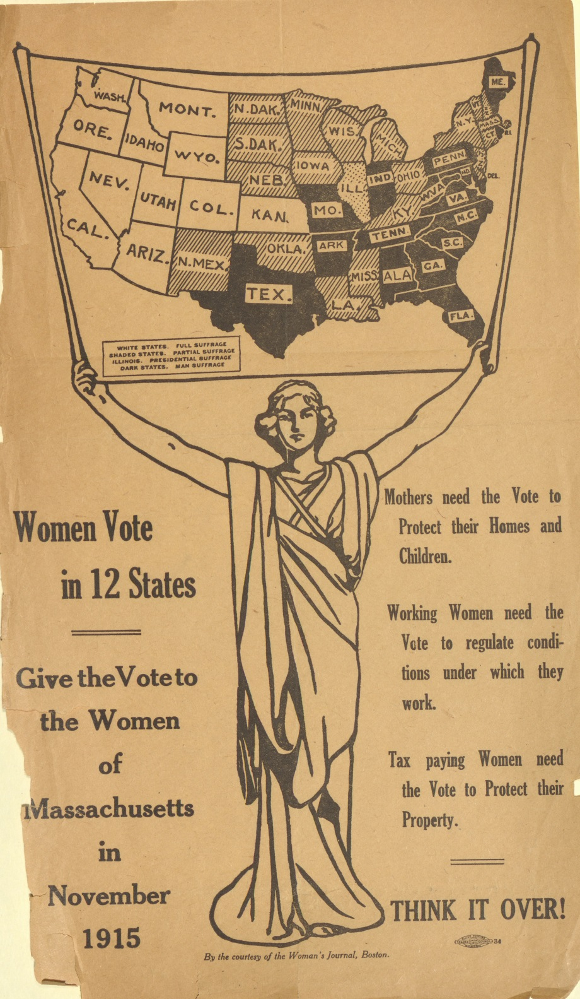
Notes:
Suffrage Scrapbook

Slide 20
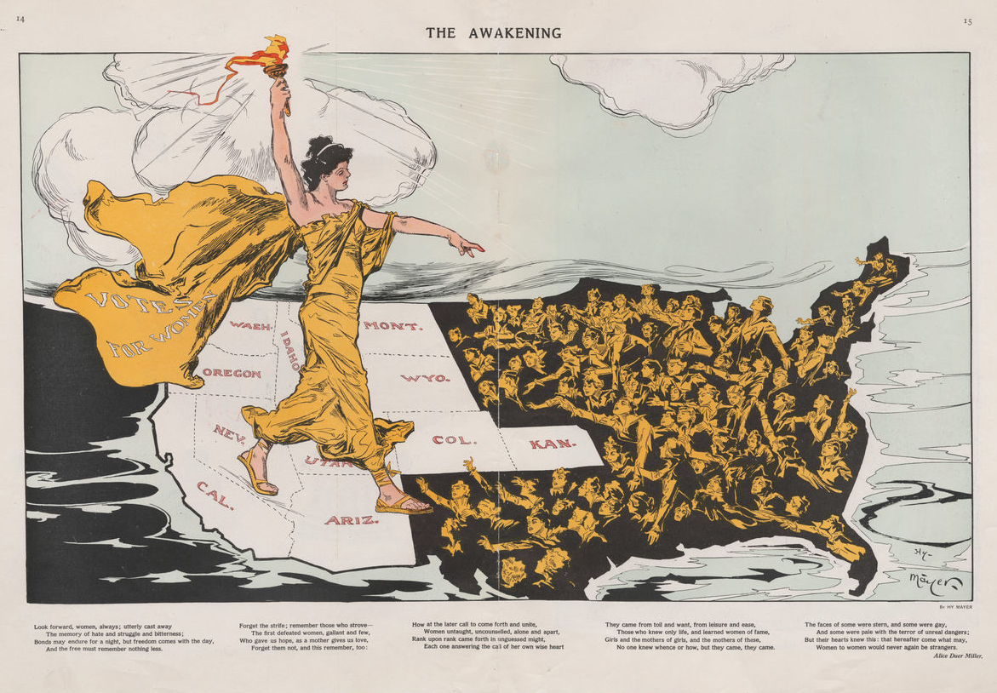
Notes:
1915 Map
Published in Puck Magazine in 1915 and illustrated by German-born artist Henry Mayer, the map depicts women with faces turned to the light that Lady Liberty is bringing east. Her flowing robes are emblazoned with the words, “VOTES FOR WOMEN.”
https://www.atlasobscura.com/articles/the-1915-map-that-helped-all-women-get-the-right-to-vote

Slide 21
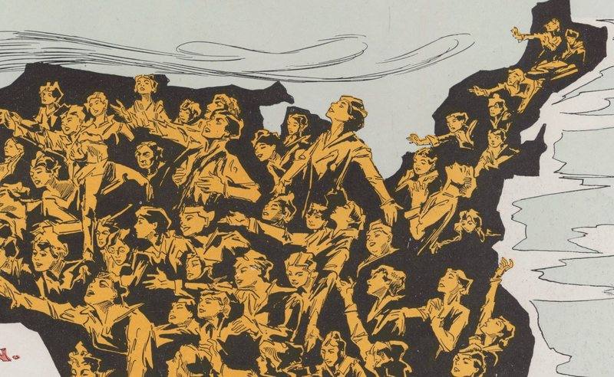
Close-up view of previous map
Notes:
Detail of same map: Vote-less women reaching towards the light

Slide 22
Reflection
Why was geography an important theme in the suffrage movement?
What were suffragists’ reasons for distributing maps?
How can artists and mapmakers use images to change peoples’ minds?
What can these maps tell us about the time period in which they were created?
Do you think maps like this would be effective today? Why or why not?
Notes:
Image source: https://www.google.com/url?sa=i&source=images&cd=&cad=rja&uact=8&ved=2ahUKEwj2rfKb4e3gAhWKTd8KHdgcAvMQjB16BAgBEAQ&url=https%3A%2F%2Fwww.seniorconcerns.org%2Fscreening-for-memory-loss%2Fhungry-dog%2F&psig=AOvVaw0jK_OiI2t4HGPEKeXzV7mI&ust=1551970076026909

