Slide 1
Image Guide Cartooning for a Cause: How Maine artist Lou Rogers’ comics influenced the nation
Women’s Long Road
Teacher Materials, Lesson 1
Maine State Museum
2019

Slide 2
Part 1: Introduction to Cartoons
Notes:
http://cbldf.org/2017/03/she-changed-comics-lou-rogers-advocate-for-womens-rights/

Slide 3
Sharing messages using images, 1913
Notes:
Anti-suffrage cartoon in Life Magazine, 1913. Text reads “Militants… As they are… As they think they are… As they appear to the police and shopkeepers.”

Slide 4
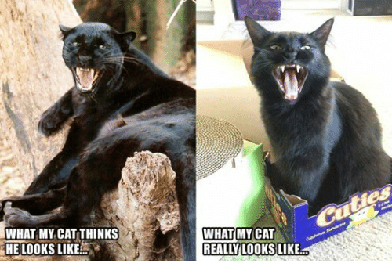
Sharing messages with images today

Slide 5

Notes:
Gal Gadot, 2017 Wonder Woman movie

Slide 6

Who is Wonder Woman?
Super Powers:
superhuman strength and durability
the power of flight
superhuman speed, reflexes, and agility
enhanced senses, including smell, vision, and hearing.
Primary weapon:
The Lasso of Truth, which makes people obey and tell the truth
Notes:
https://www.bustle.com/p/what-are-wonder-womans-powers-the-superhero-has-more-than-a-golden-lasso-60024

Slide 7


Slide 8
Why does she matter?
Wonder Woman is the World’s most famous superheroine
Only female superhero to be continuously published in comics since her first appearance in 1941
In 2016, the United Nations designated Wonder Woman as the UN Honorary Ambassador for the Empowerment of Women and Girls
Notes:
https://newsok.com/article/5526299/wonder-woman-celebrates-75-years

Slide 9
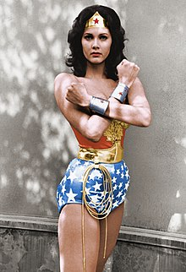
Why does she matter?
“The greatest honor and responsibility of playing Wonder Woman was serving as a role model for fans around the world, particularly girls. I've seen firsthand how a powerful yet compassionate superhero can inspire women to believe in themselves and men to support equality.”
-Linda Carter, Actress who played Wonder Woman in the 1970’s TV series
Notes:
https://newsok.com/article/5526299/wonder-woman-celebrates-75-years

Slide 10
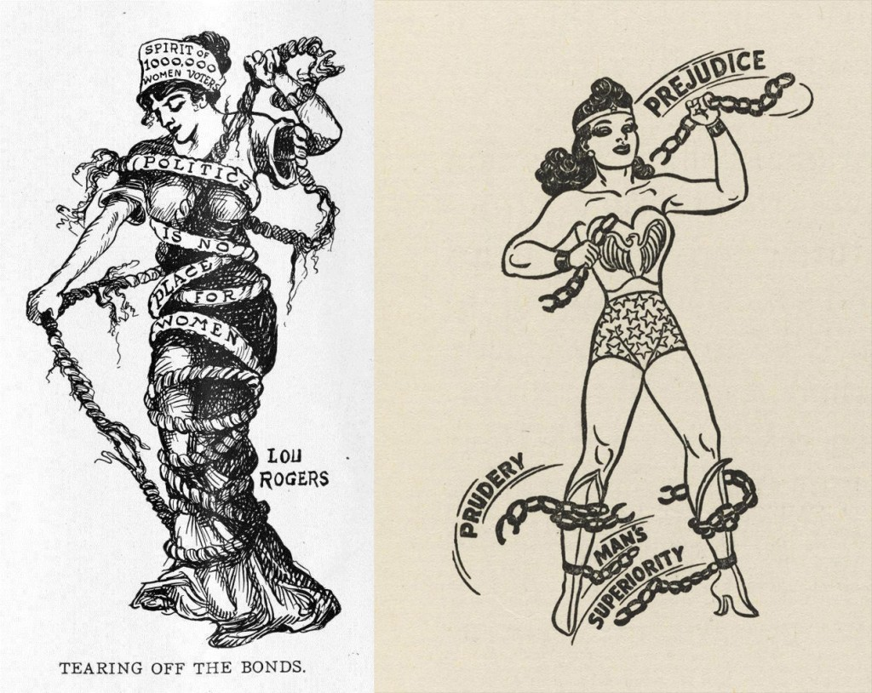
Wonder Woman’s secret history
Women’s suffrage
Cartoon by Lou Rogers
Wonder Woman
drawing by Harry Peter

Slide 11
Part 2: Lou Rogers
“Editors said there were no women cartoonists. They said women couldn’t even draw jokes. They hadn’t any humor.”
-Friend of Lou Rogers, Lewiston Daily Sun, 1924
Notes:
http://cbldf.org/2017/03/she-changed-comics-lou-rogers-advocate-for-womens-rights/

Slide 12
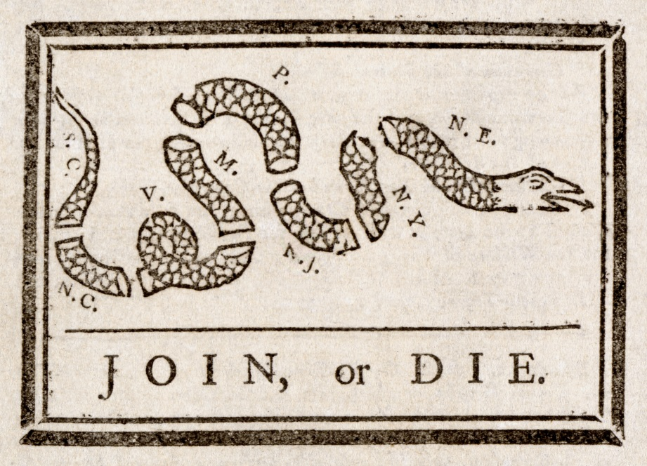
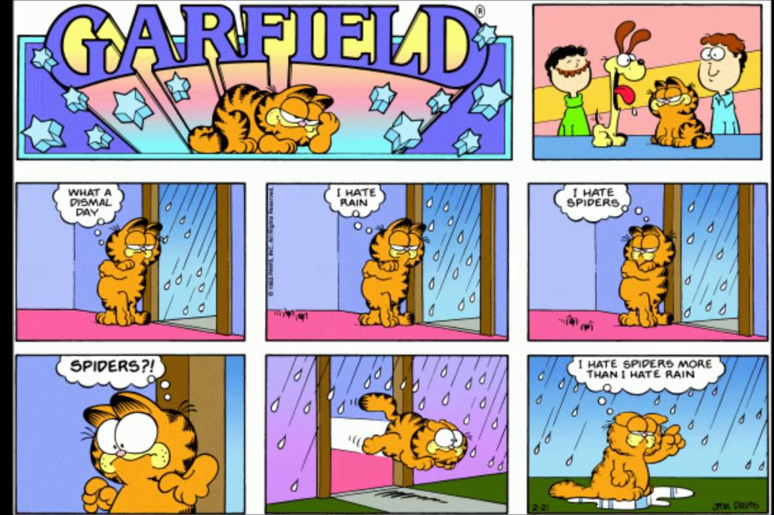
Let’s take a quick break to figure out the difference
Political cartoons
Comics
Single panel
One-time story with a temporary character or subject
Carry a message about the world, often with humor
Often have multiple panels
Often follows the same characters from week to week
Sometimes have a message but humor is usually the main point

Slide 13
Part 3: The Power of Symbols
Symbol (Noun):a thing that represents or stands for something else, especially a material object representing something abstract.
Notes:
http://cbldf.org/2017/03/she-changed-comics-lou-rogers-advocate-for-womens-rights/

Slide 14
Part 4: Image Analysis
Learning to use Observation and interpretation
Notes:
http://cbldf.org/2017/03/she-changed-comics-lou-rogers-advocate-for-womens-rights/

Slide 15
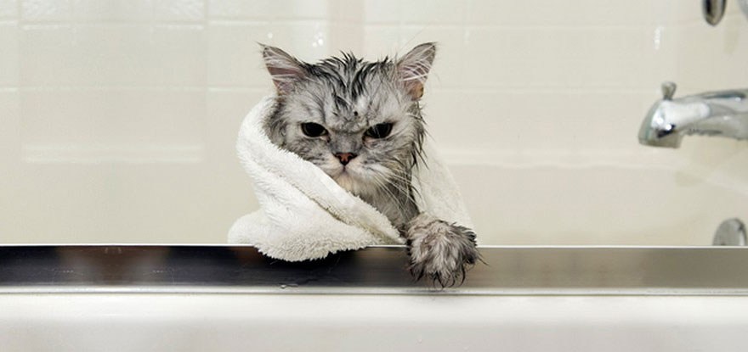
Warmup Activity: What do you see?

Slide 16
Observation vs. Interpretation
An observation is a basic description of what you see, like a list of the objects and factual details in the image.
An interpretation is a reflection on what the image means and the relationships between the things in the image. It includes what you think is happening and why. Use evidence from the image to back up your interpretation.
Notes:
Image source: https://www.google.com/url?sa=i&source=images&cd=&cad=rja&uact=8&ved=2ahUKEwj2rfKb4e3gAhWKTd8KHdgcAvMQjB16BAgBEAQ&url=https%3A%2F%2Fwww.seniorconcerns.org%2Fscreening-for-memory-loss%2Fhungry-dog%2F&psig=AOvVaw0jK_OiI2t4HGPEKeXzV7mI&ust=1551970076026909

Slide 17
1. Observation
Fact
Describe what you see
2. Interpretation
Opinion
Reflect on what you see (remember to explain your evidence!)

Slide 18
1. Observations
There is a gray cat
There is a faucet
There is a towel on the cat
Its fur looks matted and wet
LET’S GO OVER IT TOGETHER!
2. Interpretation
The cat looks like it has just had a bath because it is in a tub and has wet fur.
Someone is probably in the process of drying the cat because we see a towel.
The cat looks unhappy because of its facial expression (angry eyes) and the fact that cats usually don’t like water.
This cat is probably someone’s pet because it is inside a home and must be pretty tame or no one would dare try to give it a bath.

Slide 19
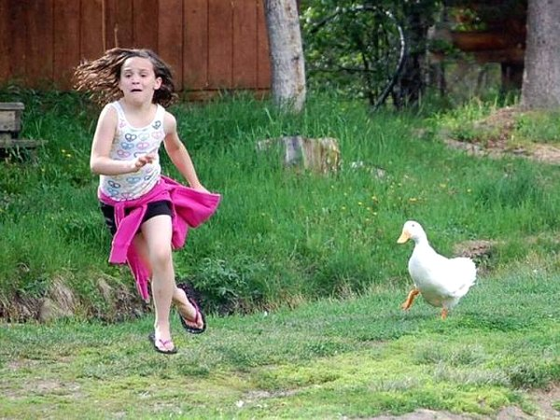
Practice Image Analysis: What do you see?
Observations
(Fact)
2. Interpretations
(Opinion)

Slide 20
Part 5: Cartoon Analysis
Tips and techniques to understand political cartoons
Notes:
http://cbldf.org/2017/03/she-changed-comics-lou-rogers-advocate-for-womens-rights/

Slide 21
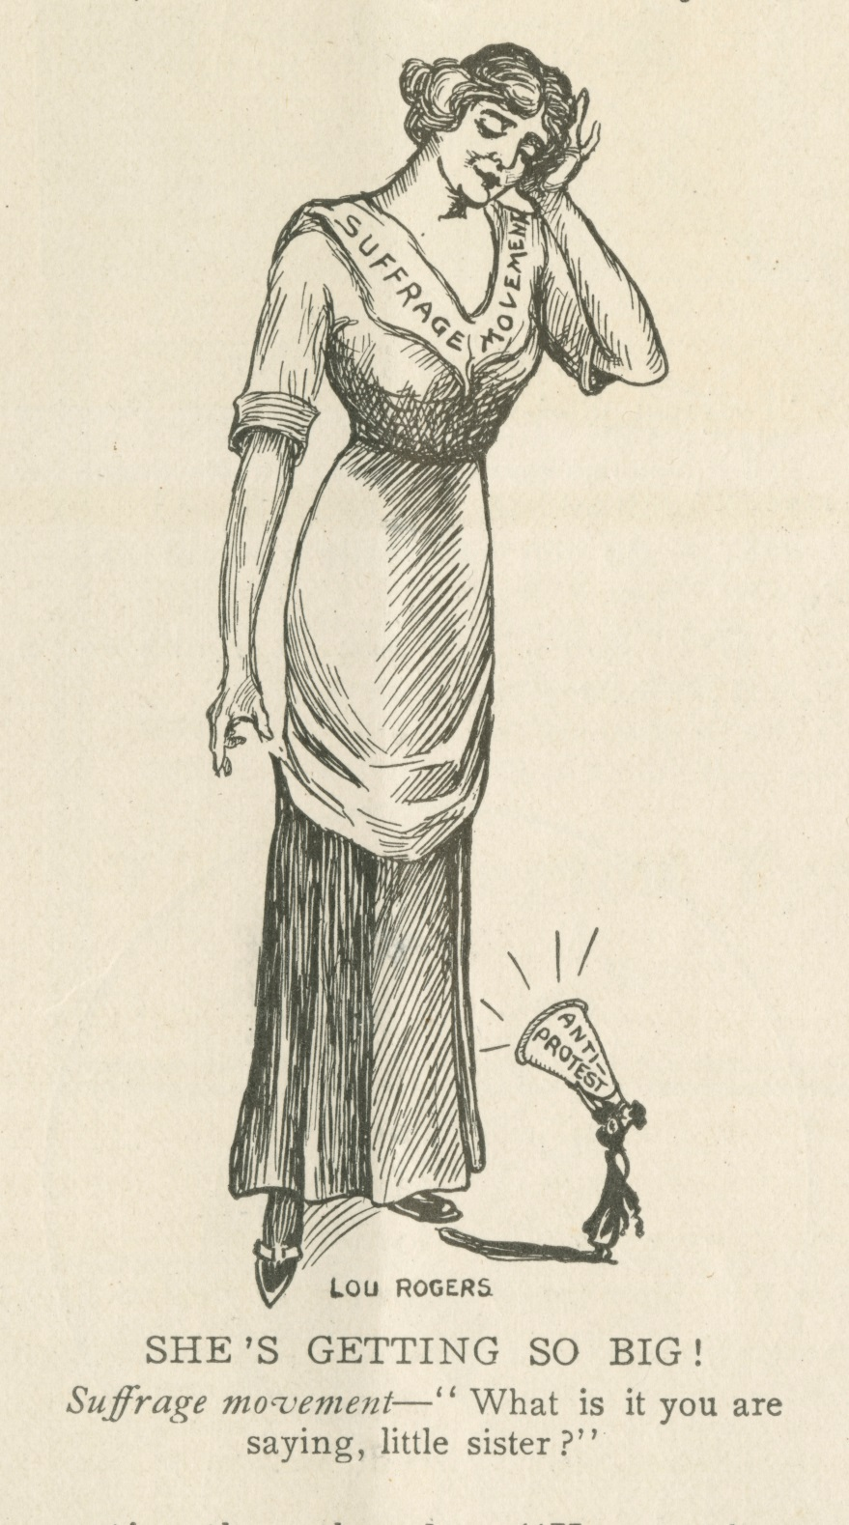
Analyzing Lou Rogers’ Cartoons
Let’s Try One Together!

Slide 22
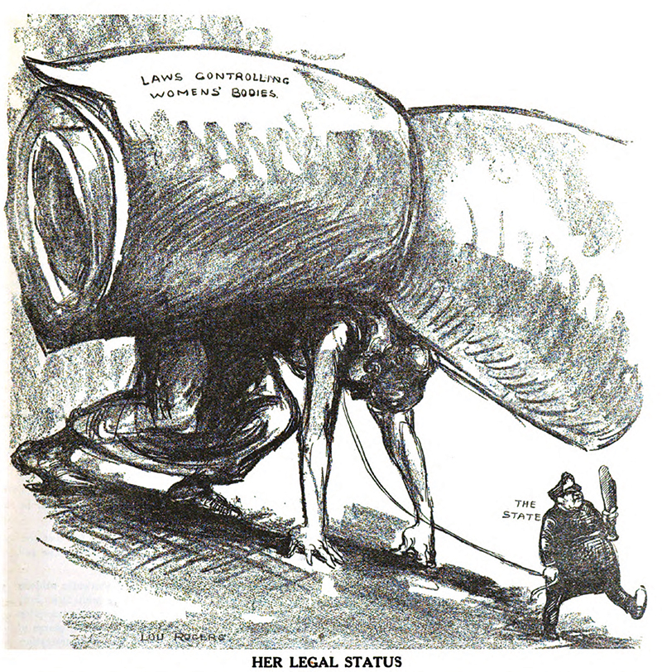
Analyzing Lou Rogers’ Cartoons

Slide 23
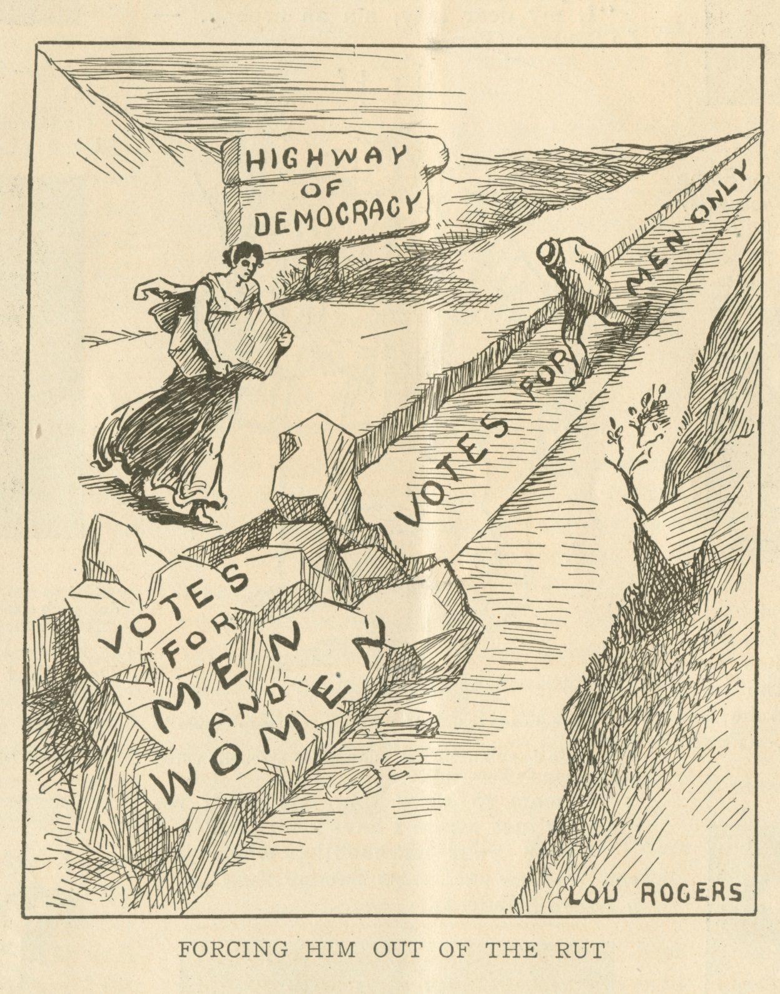
Analyzing Lou Rogers’ Cartoons

Slide 24
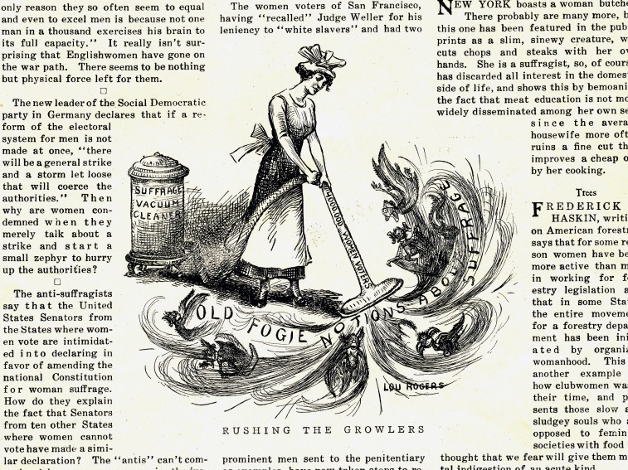
Analyzing Lou Rogers’ Cartoons

Slide 25
Reflection Questions
What can a cartoon tell us about a time period, place, a people, or the intent of the creator?
How are images and symbols used to influence individuals and society?
How can you use evidence to support an argument about an image?
What is the difference between observation and interpretation?
What persuasive techniques are used in political cartoons?
How and why did political cartoons contribute to the women’s suffrage movement?

